Slide 1

Algorithms and Data Structures 1 CS 0445
Fall 2023
Java Review – Part 3
Sherif Khattab
ksm73@pitt.edu
(Slides are adapted from Dr. Ramirez’s and Dr. Farnan’s CS1501 slides.)

Slide 2
Announcements
Recitations start this week
Lab 1 posted on Canvas
Programming Assignment 1 and Homework Assignment 2 posted this Friday

Slide 3
Today’s Agenda
Java Review – Part 3
Java Generics
Copying objects
Shallow, deep, and deeper copying
Exceptions
File Operations

Slide 4
Generic Classes: How to Define
Example: A bag of items of any reference type
public class Bag<T> {
ArrayList<T> contents;
…
public void add(T item) { … }
…
public T randomItem() { … }
…
}

Slide 5
Generic Classes: How to Use
Bag<String> stringBag = new Bag<String>();
String replaces T in class definition
String is an actual type parameter
T is a formal type parameter
We can omit the actual type parameter when it can be inferred
Bag<String> stringBag = new Bag<>();
<> is called the diamond operator

Slide 6
Generic Classes: How to Use
public class ShoppingBag extends Bag<String> {
…
}
public class ShoppingBag<T> extends Bag<T> {
…
}
public class ShoppingBag<T> extends Bag<String> {
…
}

Slide 7
Generic Methods: How to Define and Use
Example: a method that adds to an ArrayList
public <T> void addToList(T item, ArrayList<T> list){
list.add(item);
}
ArrayList<String> stringList = new ArrayList<>();
addToList("First", stringList);
addToList("Second", stringList);
addToList(10, stringList);//compilation error!

Slide 8
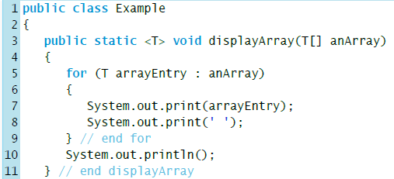
Generic Methods
One can also add type parameters to methods
Actual types are implied from argument types and/or return type
Integer[] numbers = new Integer[5];
displayArray(numbers);//T → Integer

Slide 9
Generic Interfaces: How to Define and Use
public interface Comparable<T> {
public int compareTo(T other);
}
public final class MyClass
implements Comparable<MyClass> {
…
public int compareTo(MyClass other} { … }
…
}

Slide 10
Innerworkings of Generics
Type parameters are used for type checking at compile time only
Bag<String> stringBag = new Bag<>();
stringBag.add(10);
Compilation Error!
Type parameters are erased after compilation
Replaced by highest possible type (in Java class hierarchy)
called Type Erasure
public final class Bag<T> {
ArrayList<T> contents;
…
public void add(Object item) { … }
…
public Object randomItem() { … }
…
}

Slide 11
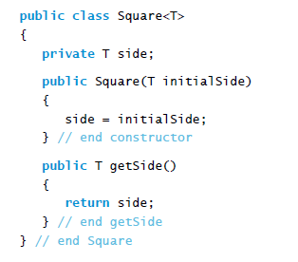
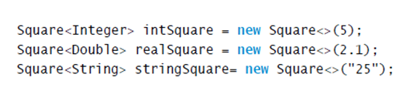
Bounded Type Parameters
Type parameters sometimes need to be bounded
What is wrong in the following example?
public class Square<T extends Number>

Slide 12
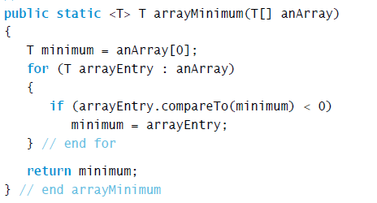
Bounded Type Parameters
A static generic method that returns the smallest object in an array
What is wrong here?

Slide 13
Bounded Type Parameters
Upper bounding using extends
<T extends Number>
Any type that is Number or lower (subtype)
<T extends Comparable<T> >
extends used with interfaces as well
Lower bounding using super
<T super String>
Any type that is String or higher (supertype)

Slide 14
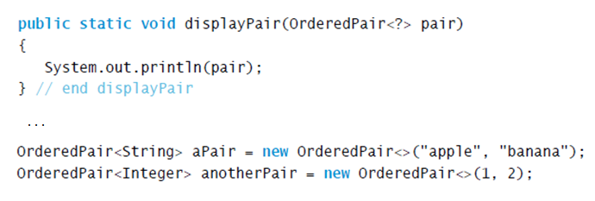
Wildcards in Generic Types
Question mark (?) means an unknown class type
Referred to as a wildcard
Method displayPair will accept as an argument a pair of objects whose data type is any one class

Slide 15
Using Wildcards
You can use ? instead of a type parameter if you don’t want to specify any dependencies
ArrayList<?>, not ArrayList<Object>, is a superclass of all ArrayList parameterized types, such as ArrayList<Integer>, ArrayList<String>, etc.
ArrayList<? extends Integer> is a supertype of ArrayList<Integer> and ArrayList<Double>

Slide 16
Recall Java Type Rules
Right-hand side of an assignment must be a subclass (or the same class) of left-hand side
A a = new B(); //B must be a subclass of A
Actual parameter of a method must be a subclass (or the same class) of formal parameter
void f(A a) { …}
f(new B()); //B must be a subclass of A

Slide 17
Examples
ArrayList<?> is a supertype of all parametrized ArrayList types
such as ArrayList<Integer>, ArrayList<String>, etc.
ArrayList<?> list = new ArrayList<Integer>();
OK!
ArrayList<? extends Integer> is a supertype of ArrayList<Integer>
ArrayList<? extends Integer> list = new ArrayList<Integer>();
OK!
Integer is a subtype of Object but ArrayList<Integer> is not a subtype of ArrayList<Object>
ArrayList<Object> list = new ArrayList<Integer>();
Compilation error!
Similarly, ArrayList<? extends Integer> is not a subtype of ArrayList<Integer>
ArrayList<Integer> list = new ArrayList<? extends Integer>();
Compilation error!
ArrayList<Object> is not a superclass of ArrayList<?>

Slide 18
More Examples
ArrayList<Integer>[] lists = new ArrayList<?>[3];
compilation error!
why?
ArrayList<Integer>[] lists = new Object[3];
compilation error!

Slide 19
Arrays of Generics
Java doesn’t allow creation of arrays of generic types
T[] array = new T[10];
Compilation Error!
Java doesn’t allow creation of arrays of parametrized types
ArrayList<Integer>[] array = new ArrayList<Integer>[10];
Compilation Error!
Loophole possible if generic array creation was allowed
ArrayList<Integer>[] lists = new ArrayList<Integer>[10];
ArrayList<String> strings = new ArrayList<>();
strings.add(“First”);
Object[] array = list; //OK! why?
array[0] = strings;//Also OK! why?
Integer x = array[0].get(0); //Exception! Not caught by comiler

Slide 20
Copying Objects the shallow way
Shallow copy
A new reference variable is allocated but the object itself is not copied
The new reference variable points to the same object
void Square shallowCopy(Square original){
Square copy = original;
return copy;
}
copy == original and copy.equals(original)
Side effect: changes to the original object will change the copy

Slide 21
Copying Objects the deep way
Deep copy
A new reference variable and a new object are allocated
The new reference variable points to the new object
However, the data fields of the new object point to the same objects as the original
Square(Square other){ //this is called a copy constructor
sideLength = other.sideLength
area = other.area;
perimeter = other.perimeter;
}
copy != original and copy.equals(original)
Side effect: changes to the data fields of the original object will change the data fields of the copy

Slide 22
Copying Objects the deeper way
Deeper copy
A new reference variable and a new object are allocated
The new reference variable points to the new object
New objects for the data fields in the new object are allocated
New objects for the data fields within the new data field objects are allocated
…
Square(Square other){ //this is called a copy constructor
sideLength = new Integer(other.sideLength)
area = new Integer(other.area);
perimeter = new Integer(other.perimeter);
}
copy != original and copy.equals(original)
Side effect: time and memory consuming

